Slide 1
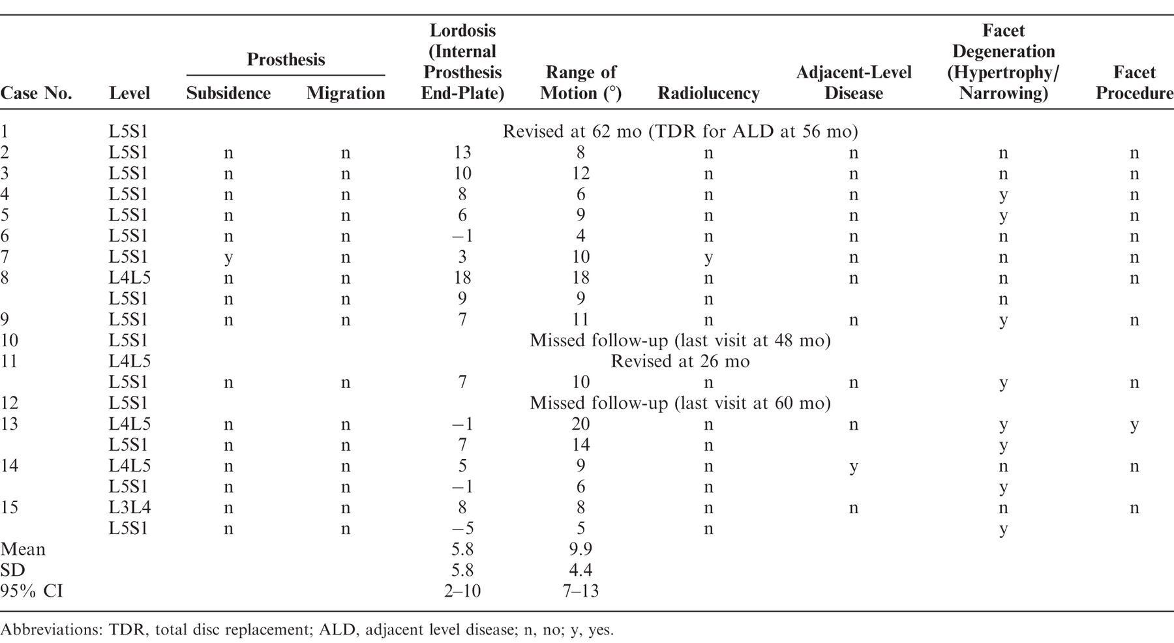

Radiological outcomes at minimum 84-month follow-up.
LUIZ PIMENTA et al. Int J Spine Surg 2018;12:49-57
©International Society for the Advancement of Spine Surgery
Notes:
Radiological outcomes at minimum 84-month follow-up.

